Slide 1
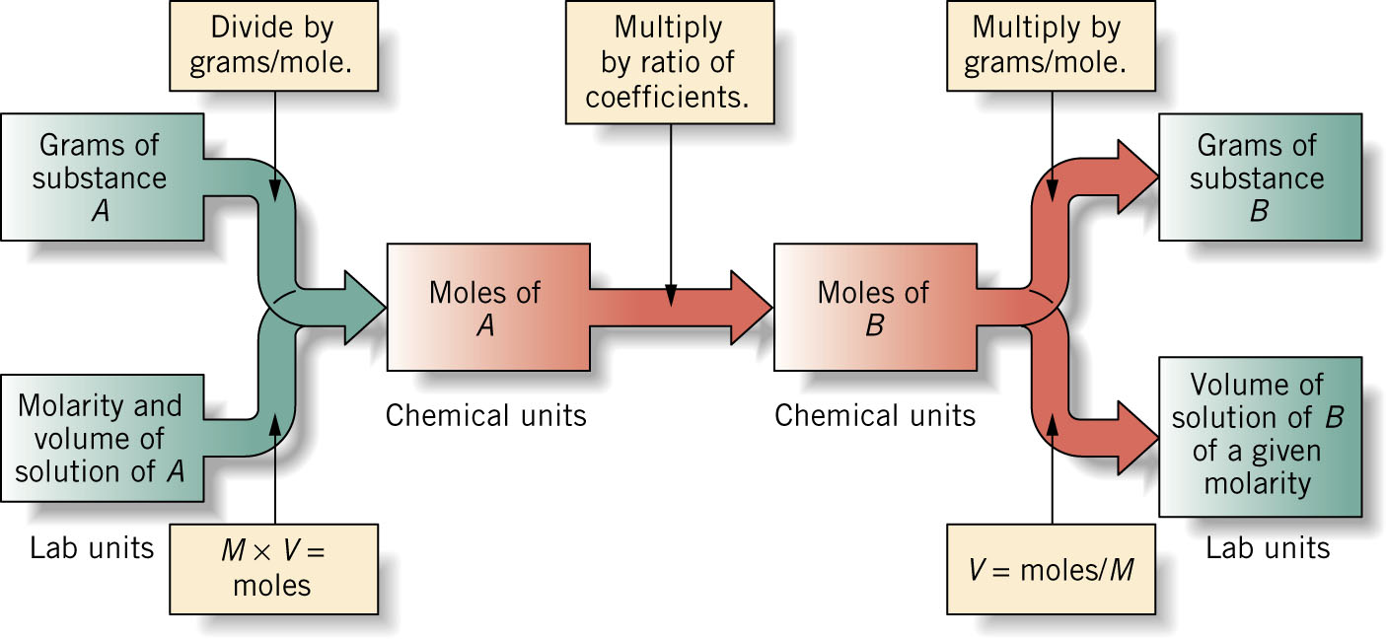
Paths for working stoichiometry problems may be summarized with a flowchart:

